Slide 1

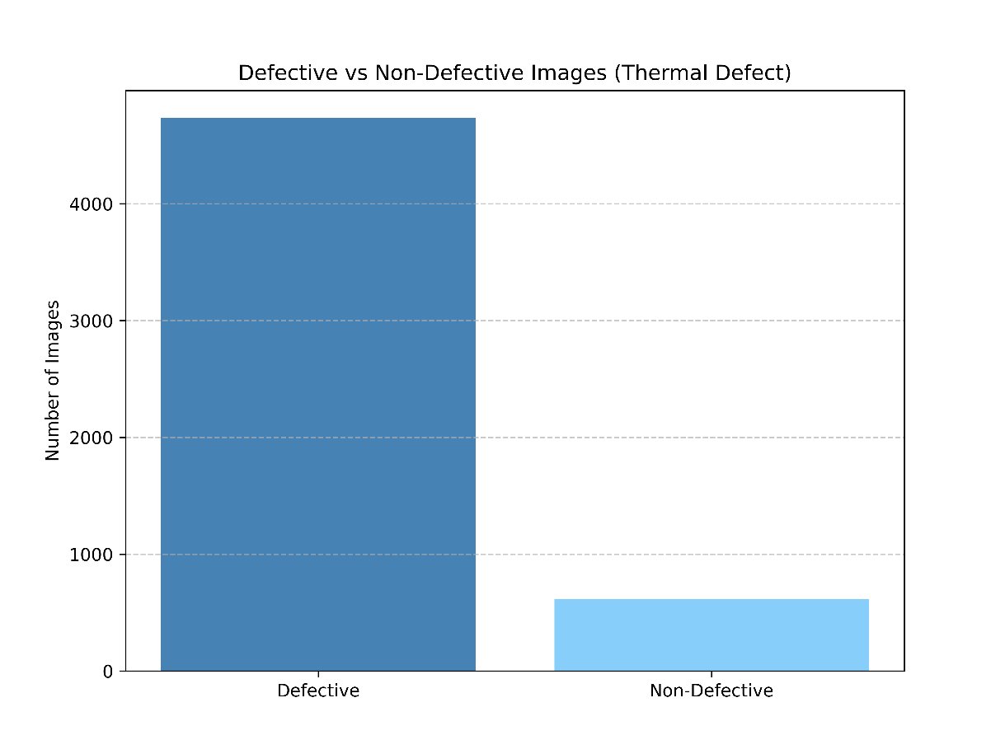
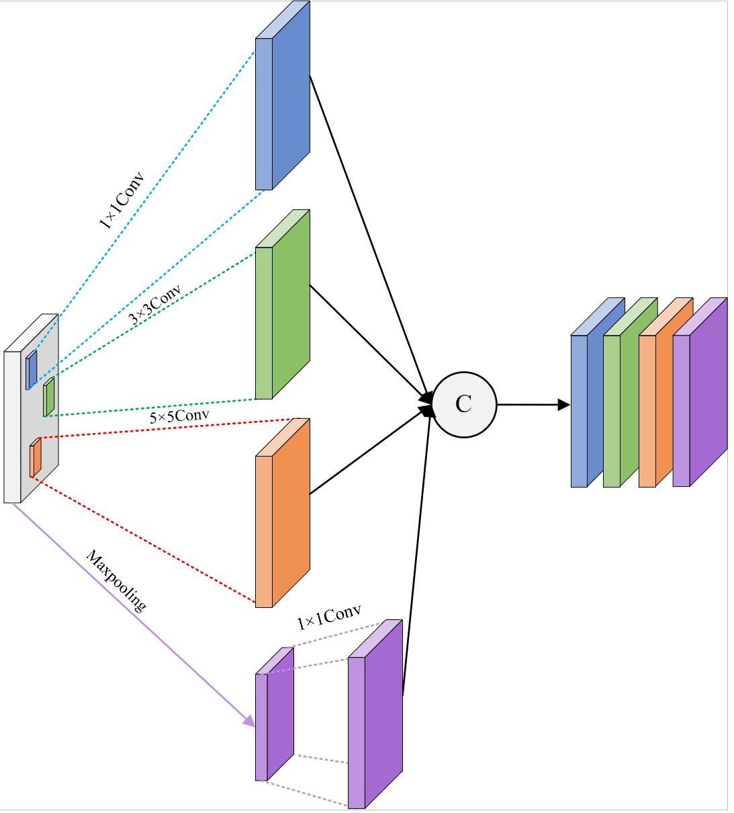
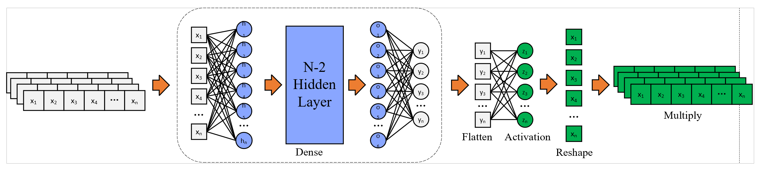
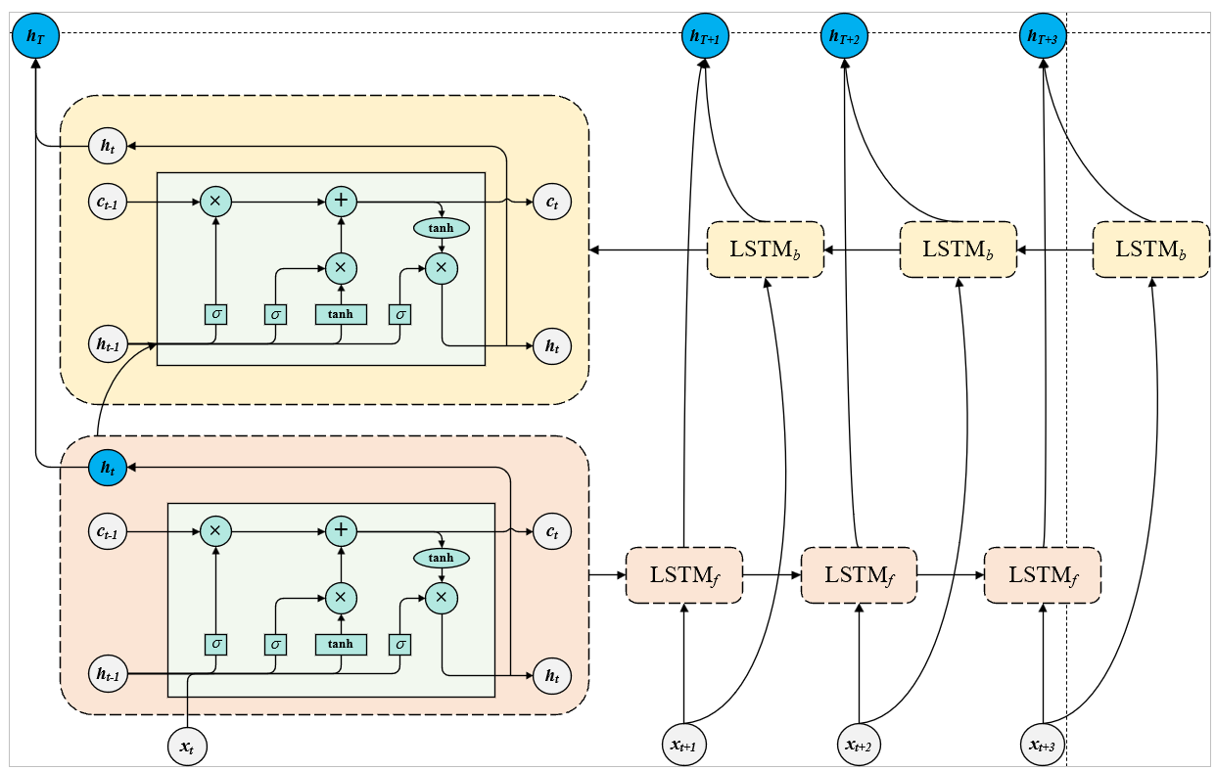
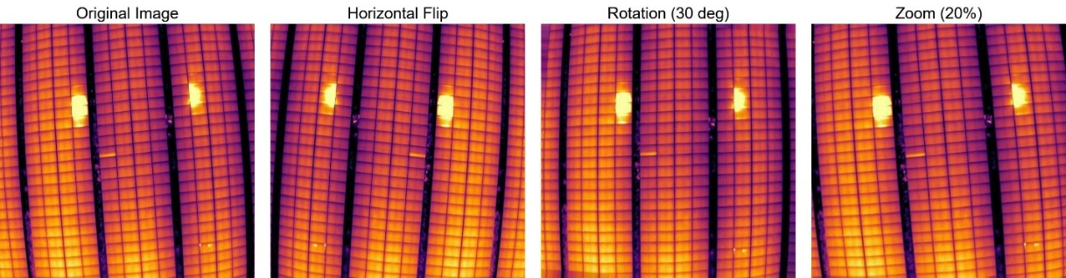
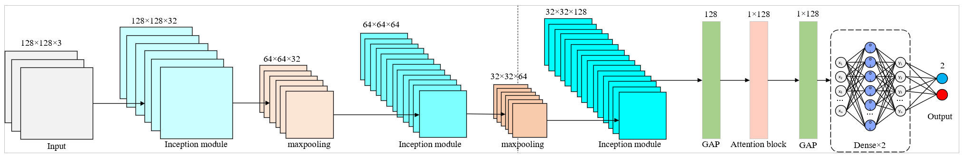
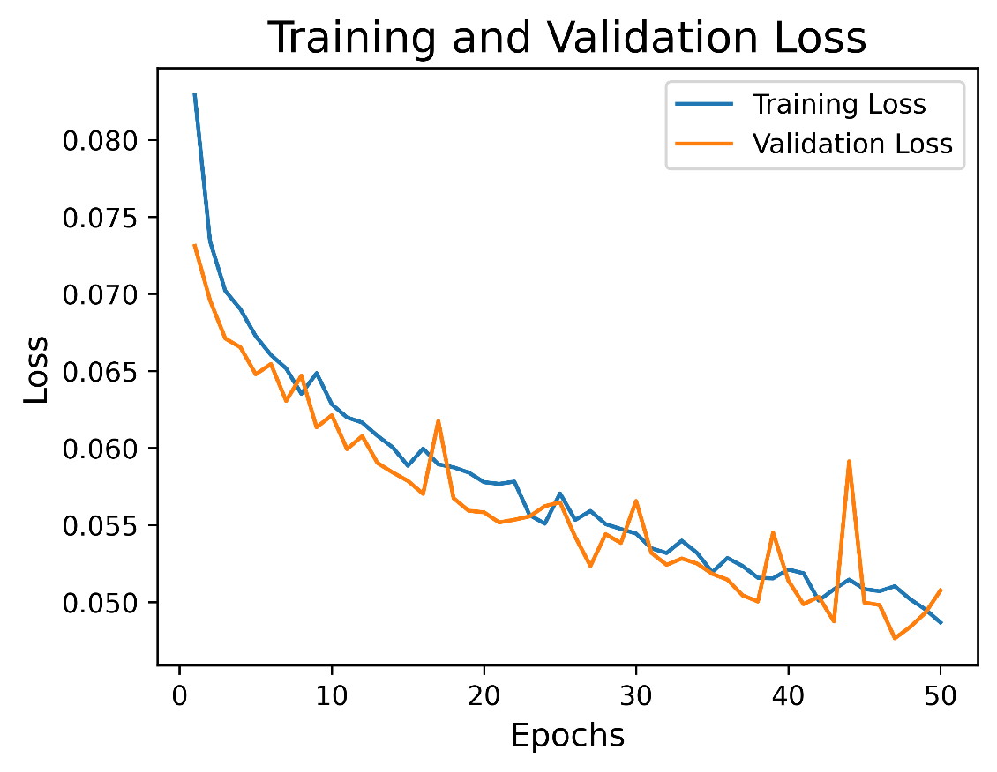
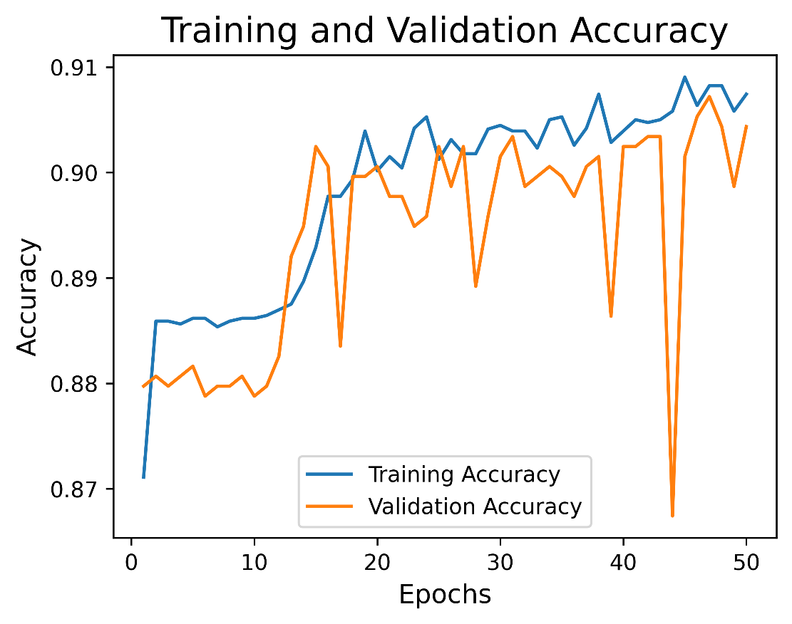
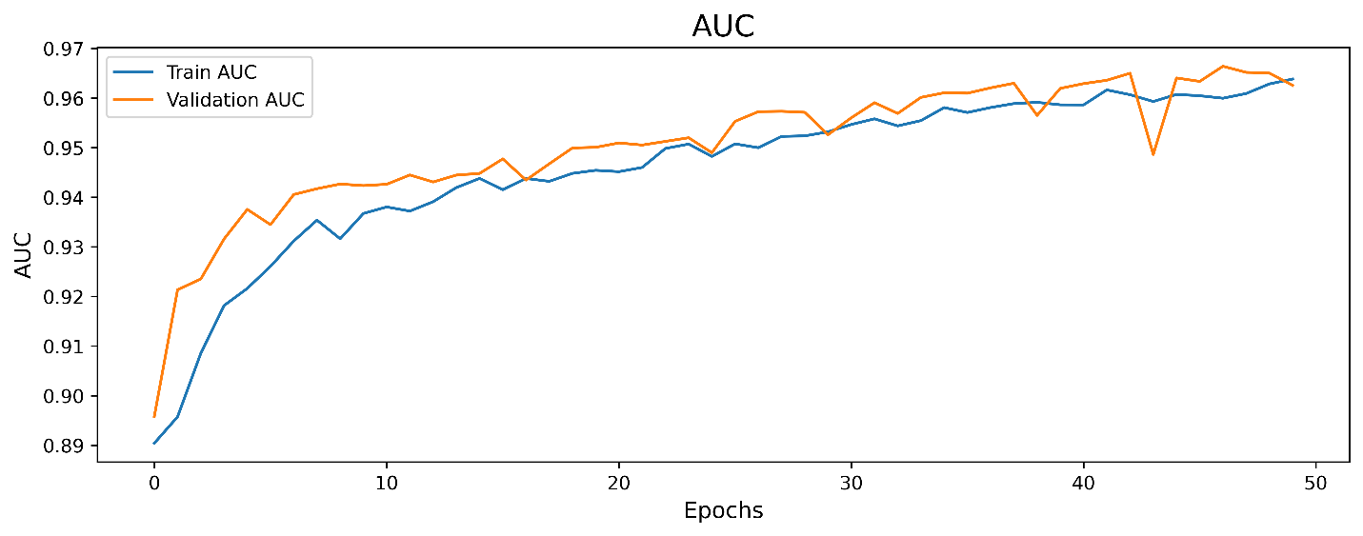
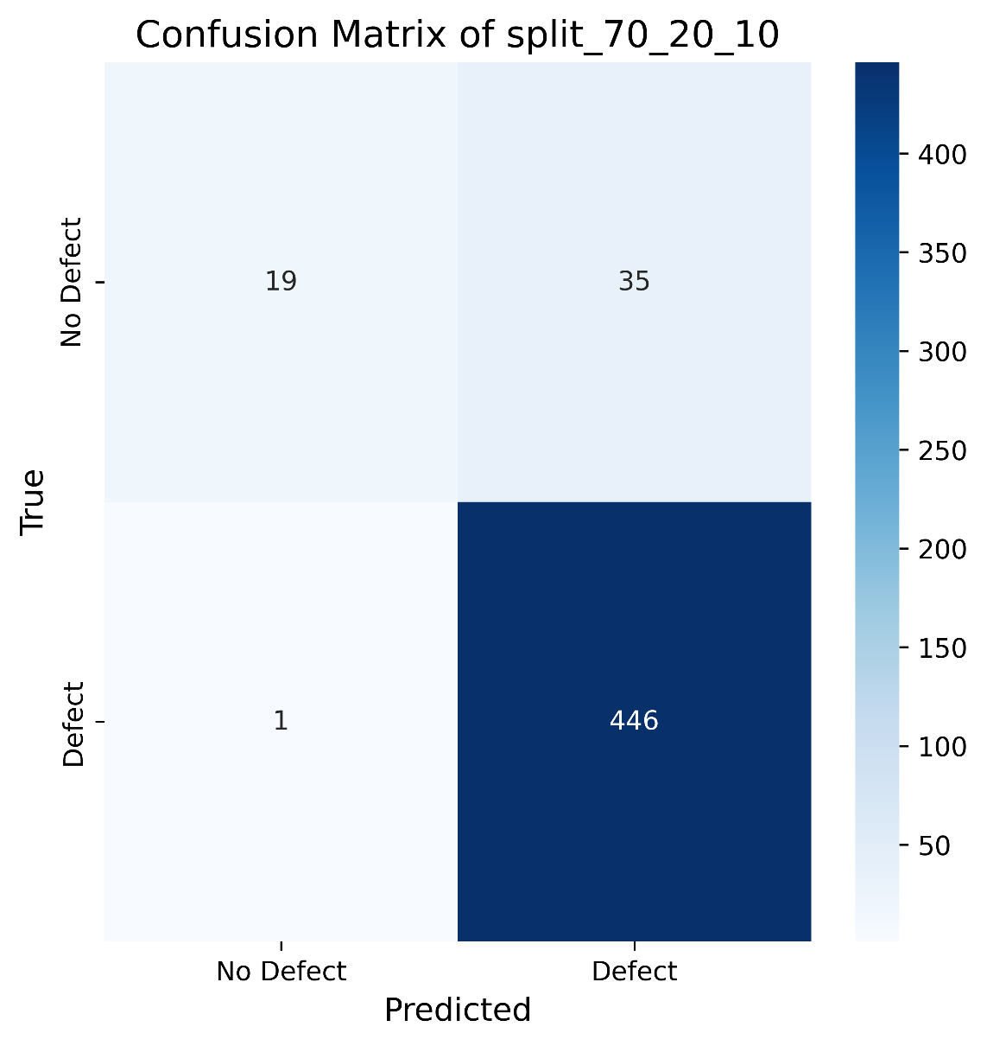
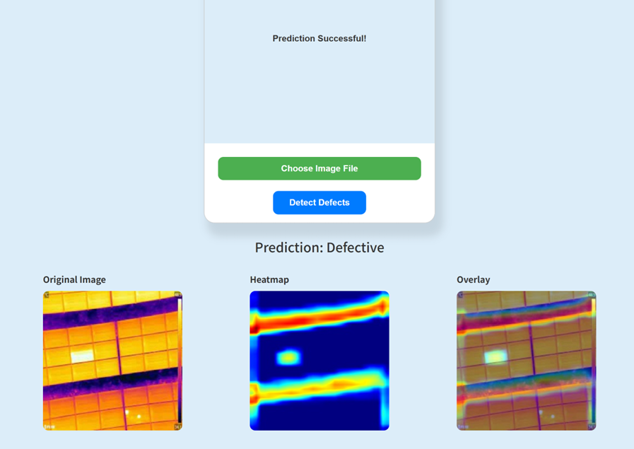
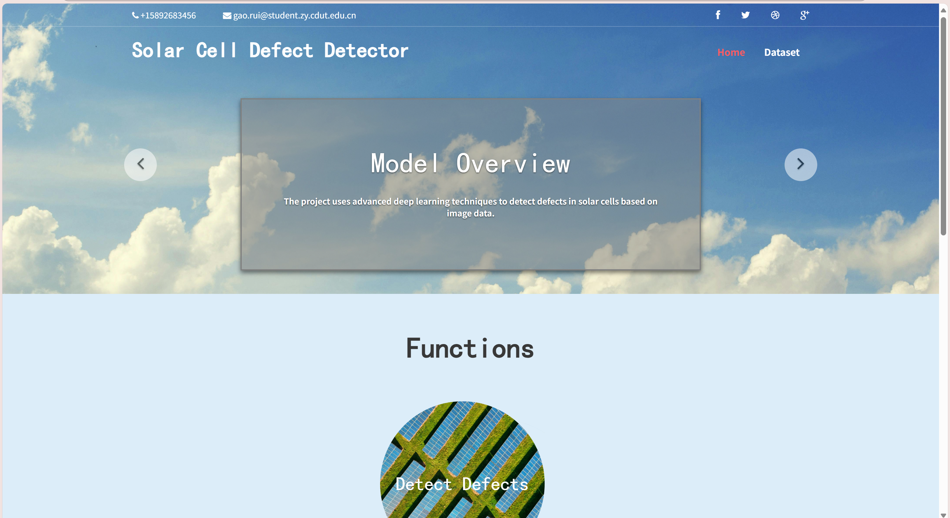
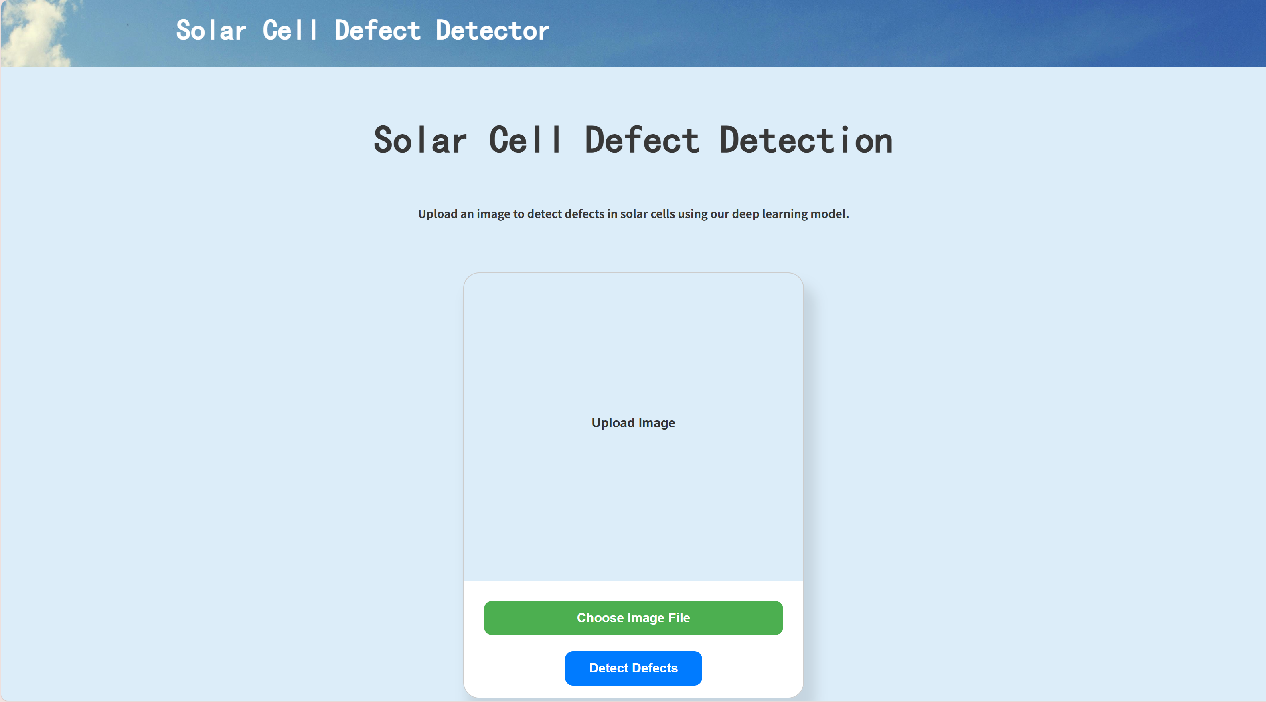


Rui Gao (Olivia)
IABiLSTM-NET on Solar Cell Detection using
Thermal Imaging
Oxford Brookes University in collaboration with Chengdu University of Technology
Supervised by Dr Happy Nkanta Monday
Abstract
Photovoltaic (PV) panels often suffer from defects such as cracks and hot spots, and manual inspection is costly and error-prone. To improve detection accuracy and robustness, this project proposes a weighted ensemble model combining Inception, BiLSTM, and Attention mechanisms. The attention module enhances focus on critical areas in thermal infrared images. Trained on 5,352 labeled images, the model achieved 91.56% accuracy, 0.9677 AUC, and a 95.33% F1-Score. A user-friendly interface allows real-time image uploads and detect defects, supporting efficient maintenance and reducing long-term costs.
Dataset
Proposed Models
The proposed model consists of five main steps. First, an RGB image with the shape (128, 128, 3) is input into the model.
Figure 4. Attention Block
The second step involves the Inception module, which extracts relevant features from the image. In the third step, a BiLSTM is applied to model temporal dependencies. The fourth step incorporates the Attention mechanism to prioritize important features.
Finally, the fully connected layer and output layer generate the final result, providing the probability of the image belonging to each category.
Figure 3. Inception Module
Figure 1. Dataset Distribution
The proposed model is a hybrid deep learning architecture combining Inception modules, Bidirectional LSTM (BiLSTM) and add an Attention mechanism
Images: 5,352 thermal images
Defective：4,733
Non-Defective：619
Figure 5. BiLSTM Module
Figure 2. Examples of data augmentation
In dataset preprocessing, the augmentation method include: rescaling, random rotation, width shift, height shift, shear transformation, zooming and horizontal flip.
Figure 6. Proposed Model
There are three Separation split ratio used in the project: 80:10:10, 70:20:10, 60:20:20.
The images are resized the pixels to 128 * 128.
Model Evaluation
Interpretability and significance analysis of the model
Figure 7. Loss curve
Figure 8. Accuracy curve
Figure 9. AUC curve
The figures above show the evaluation obtained from the proposed model with split 70:20:10 ratio and table 1 illustrates split 70:20:10 performs the best, slightly outperforming the other two ratios.
The goal of Explainable AI is to make AI systems more comprehensible and transparent without sacrificing performance. In addition, it allows non-experts to understand the model's behavior, increase user trust in AI system decisions, facilitate the diagnosis of biases or issues in the model, and ensure compliance with regulatory requirements.
Figure 10. confusion matrix
Split Ratio | Accuracy | Loss | Precision | Recall/Sensitivity | AUC | Specificity | F1-Score
80:10:10 | 0.9142 | 0.0456 | 0.9142 | 0.9142 | 0.9684 | 0.3898 | 0.9540
70:20:10 | 0.9156 | 0.0464 | 0.9156 | 0.9156 | 0.9677 | 0.3518 | 0.9533
60:20:20 | 0.8870 | 0.0559 | 0.8870 | 0.8870 | 0.9544 | 0.3284 | 0.9392
Table 1. Overall Comparison of three split radio
Model | Accuracy | Loss | Precision | Recall/Sensitivity | AUC | Specificity | F1-Score
Proposed | 0.9156 | 0.0464 | 0.9156 | 0.9156 | 0.9677 | 0.3519 | 0.9533
Inception | 0.9043 | 0.0492 | 0.9043 | 0.9043 | 0.9651 | 0.2241 | 0.9550
Inception_Attention | 0.9193 | 0.0460 | 0.9193 | 0.9193 | 0.9697 | 0.3442 | 0.9633
CNN | 0.9118 | 0.0556 | 0.9118 | 0.9118 | 0.9565 | 0.2787 | 0.9581
Table 2. Overall Comparison of four models
Figure 11. The Grad-Cam example
Model Deployment
It then uses the output of one of the convolutional layers of the model along with the predicted gradients to generate a weighted feature map, resulting in a heatmap which helping to understand the model's decision-making process. This allows us to observe the areas that the model focuses on when classifying a specific image, thereby enhancing the model's credibility
Future Work
Figure12. Web homepage to the model
Figure13. Detection page to the model
Figure14. Detection result page
Expand dataset with diverse defects.
Explore lightweight models for edge devices.
Integrate temperature and metadata.
Use advanced attention mechanisms.
Investigate self-supervised learning
Develop an end-to-end monitoring system.
The user interface (UI) is designed to showcase the proposed model. On the homepage, users can explore the website’s topic and access various functions via links. The ‘Detect Defects’ section directs users to the detection page. Scrolling down reveals the dataset section, which provides an introduction to the dataset along with a ‘Dataset Website’ button that navigates to the dataset's source.
Figure15. Dataset information page

